Slide 1
AI-Driven Cost Optimization Model for Mid-Tier Banks
Financial & Strategic Impact Assessment
Panchanand Gupta – PGDM (Great Lakes Institute of Management (Gurgaon)

Slide 2
Problem Context
Rising call center servicing costs
Increasing customer query volume
Scalability constraints in manual servicing
AI automation as cost + efficiency lever

Slide 3
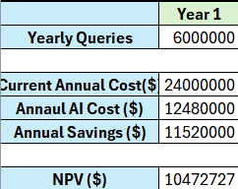
Financial Model (Base Case)

Slide 4
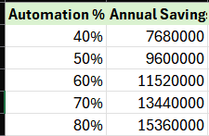
Sensitivity Analysis
Each +10% automation adds ~$1.92M incremental annual savings.

Slide 5
Strategic Implications
Strong operating leverage from automation
Rapid payback period
Viable value-based SaaS pricing model
Attractive for mid-tier banking segment

Slide 6
Risks & Governance
Data privacy & compliance
Model hallucination risk
Escalation protocols
Human-in-loop oversight

